Slide 1

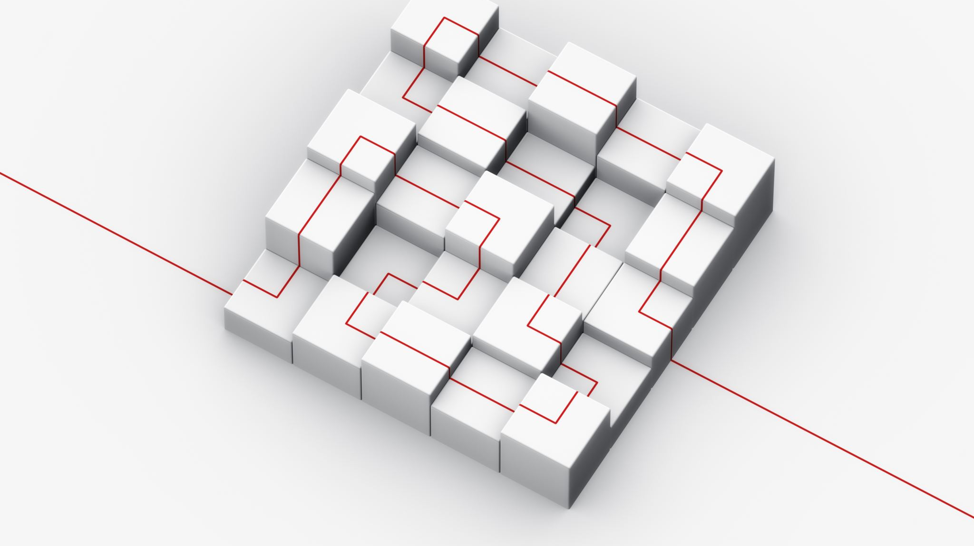
SE 577 Software Architecture Project Presentation
Cloud chef

Slide 2


Contents: Overview: Context Architecture: Container Architecture: Component Architecture: Key Architectural Decisions: Quality Attributes: Conclusion:

Slide 3

Overview
Cloud Chef is an innovative cloud-based meal delivery platform designed to connect users with a wide range of local and national restaurants, as well as top chefs, offering a diverse selection of meals delivered directly to your doorstep. Our platform stands out for its:
Diverse Culinary Options: From local favorites to gourmet dishes for all dietary preferences.
Scalability: Built to handle increasing demand and data volume effortlessly.
Resilience: A microservices architecture ensures robustness and availability.
Cost-Effectiveness: Utilizes AWS to optimize costs and offer competitive prices.
User Experience: Seamless interface for browsing, ordering, and tracking.
Innovation: Integrates the latest technologies for enhanced service delivery.

Slide 4
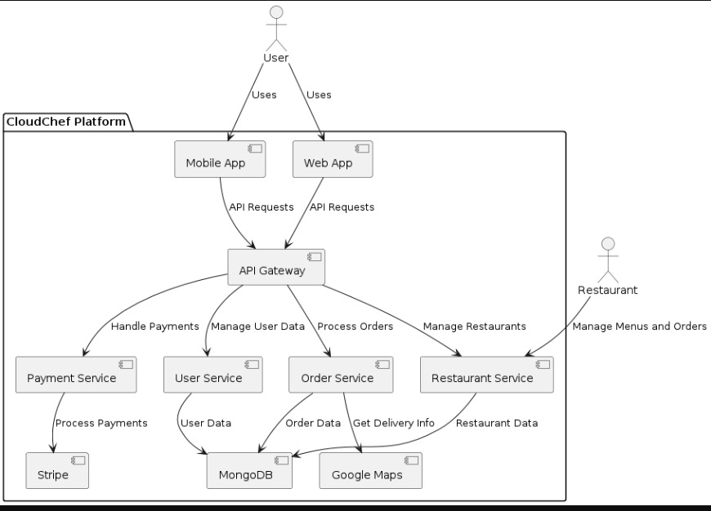
Context Architecture
Starting with the context diagram, we see how Cloud Chef interacts with users, restaurants, and third-party services like Stripe for payments and Google Maps for delivery tracking.
User can interact with Mobile & Web App.
Restaurants can interact with restaurant service.

Slide 5
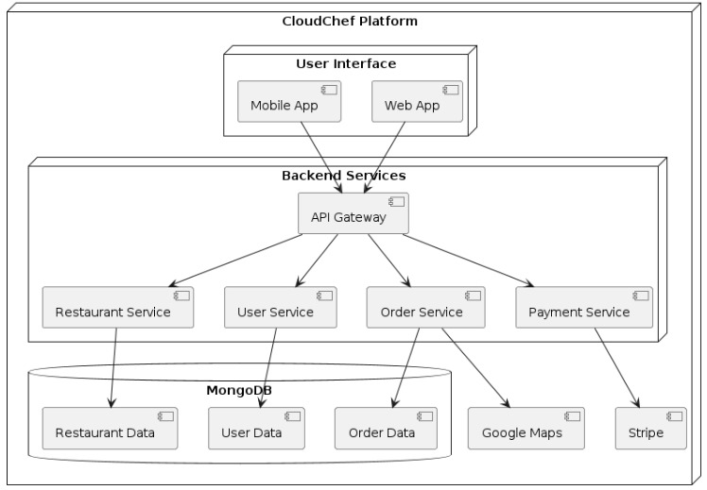
Container Architecture
The container diagram shows the main components of our system: the user interfaces, API gateway, microservices, and the database.
API connects with Restaurant Service, User Service, Order Service, Payment Service.
Microservices like google maps & stripe are connected with the order service & payment service components.
The database are restaurant data, user data and order data stored using MongoDB.

Slide 6
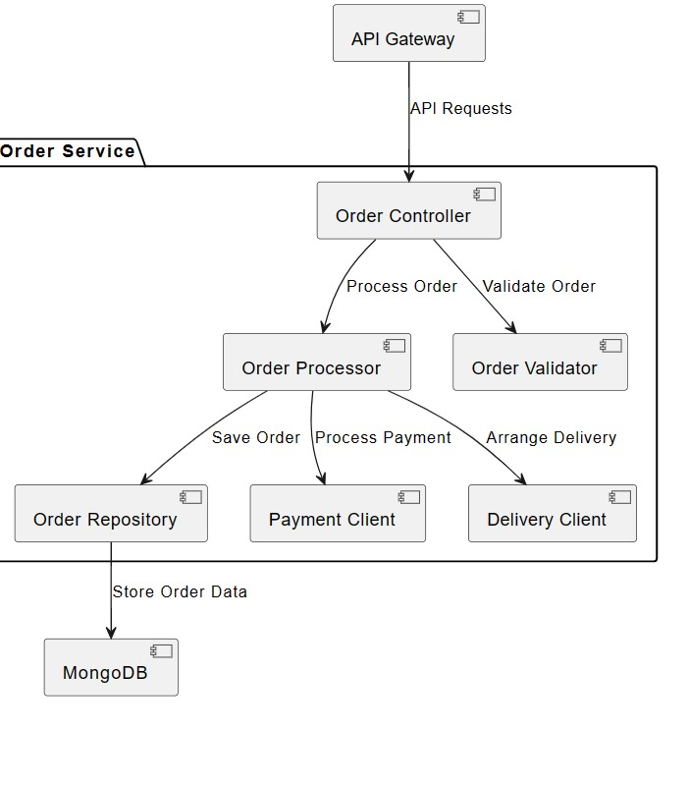
Component Architecture
Zooming in, the component diagrams detail the internal structure of the Order Service & User Service, showing the specific components and their interactions.
Order Service:

Slide 7
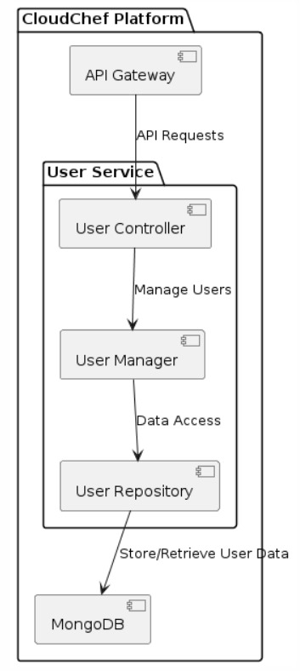
Component Diagram
Zooming in, the component diagrams detail the internal structure of the Order Service & User Service, showing the specific components and their interactions.
User Service

Slide 8
Key Architectural Decision:
We chose MongoDB for its flexibility and scalability, crucial for handling diverse data types and growing demand. Our microservices architecture supports independent scaling and fault tolerance, hosted on AWS for its comprehensive services and global reach. An API Gateway using Amazon API gateway ensures secure and managed API access and we use Oath 2.0 for secure user authentication.

Slide 9
Quality Attributes:
Our Architecture balances cost, resiliency, and scalability. AWS’s pricing model helps manage costs, while the microservices architecture and MongoDB enhance resiliency and scalability.

Slide 10
Conclusion
In summary, Cloudchef’s architecture is designed to deliver a high-quality, reliable, and scalable meal delivery service.
Thank you for your time. I’m happy to take any questions.

